Slide 1
Logistic regression
classification

Slide 2
Logistic Regression
Logistic Regression is a Machine Learning classification algorithm that is used to predict the probability of a categorical dependent variable.
In logistic regression, the dependent variable is a binary variable that contains data coded as 1 (yes, success, etc.) or 0 (no, failure, etc.).
In other words, the logistic regression model predicts P(Y=1) as a function of X.

Slide 3
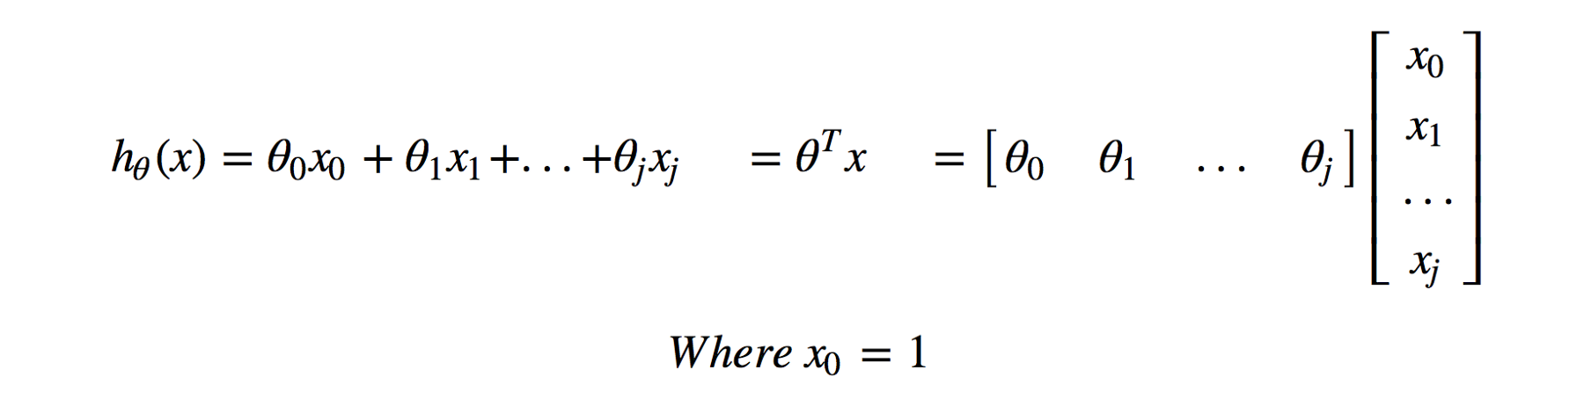
Remember the hypothesis of linear regression

Slide 4
Logistic regression
Logistic regression just has a transformation based on Linear regression hypothesis.
For logistic regression, focusing on binary classification here, we have class 0 and class 1.
To compare with the target, we want to constrain predictions to some values between 0 and 1.
That’s why Sigmoid Function is applied on the raw model output and provides the ability to predict with probability.

Slide 5


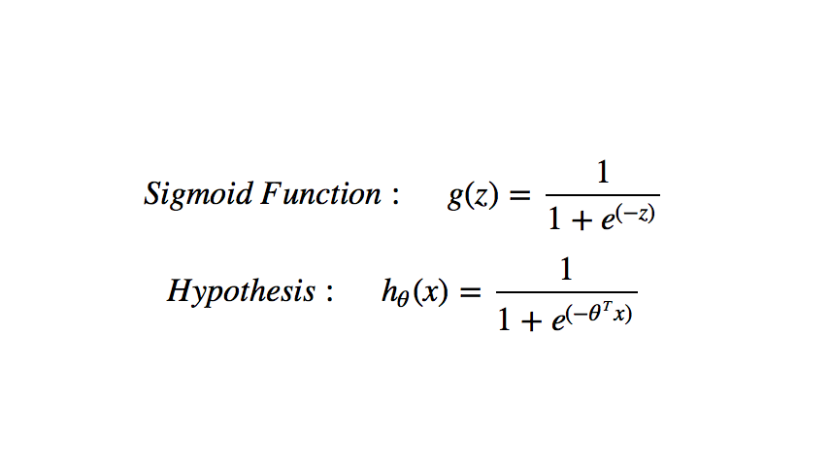
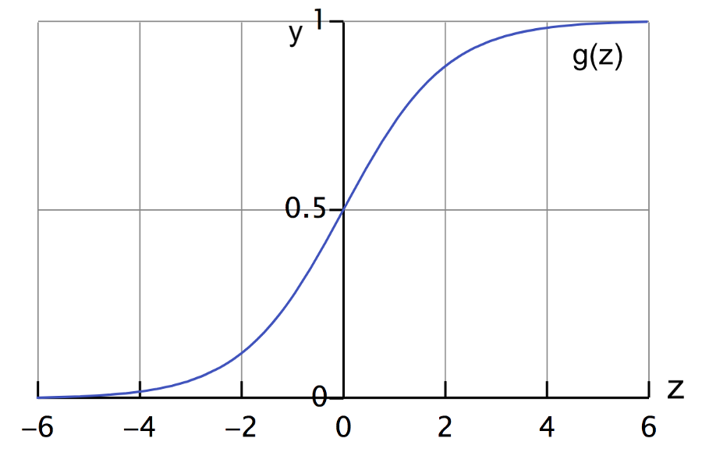
Logistic regression
What hypothesis function returns is the probability that y = 1, given x, parameterized by θ, written as: h(x) = P(y = 1|x; θ).
Decision boundary can be described as: Predict 1, if θᵀx ≥ 0 → h(x) ≥ 0.5; Predict 0, if θᵀx < 0 → h(x) < 0.5.

Slide 6
Logistic Function
The logistic function, also called the sigmoid function was developed by statisticians to describe properties of population growth in ecology, rising quickly and maxing out at the carrying capacity of the environment. It’s an S-shaped curve that can take any real-valued number and map it into a value between 0 and 1, but never exactly at those limits : 1 / (1 + e^-value)
Where e is the base of the natural logarithms (Euler’s number or the EXP() function in your spreadsheet) and value is the actual numerical value that you want to transform.

Slide 7
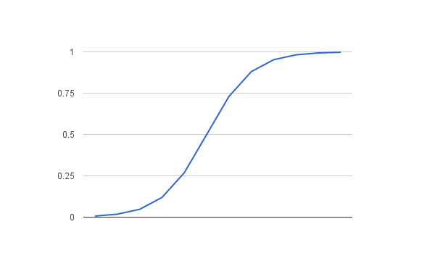
Logistic Function
plot of the numbers between -5 and 5 transformed into the range 0 and 1 using the logistic function.

Slide 8
Logistic Regression
Input values (x) are combined linearly using weights or coefficient values (referred to as the Greek capital letter Beta) to predict an output value (y).
A key difference from linear regression is that the output value being modeled is a binary values (0 or 1) rather than a numeric value.
Below is an example logistic regression equation:
y = e^(b0 + b1*x) / (1 + e^(b0 + b1*x))
Where y is the predicted output, b0 is the bias or intercept term and b1 is the coefficient for the single input value (x).
Each column in your input data has an associated b coefficient (a constant real value) that must be learned from your training data.
The actual representation of the model that you would store in memory or in a file are the coefficients in the equation (the beta value or b’s)

Slide 9
Technical Interlude
Logistic regression models the probability of the default class (e.g. the first class).
For example, if we are modeling people’s sex as male or female from their height, then the first class could be male and the logistic regression model could be written as the probability of male given a person’s height, or more formally like below point.
P(sex=male|height)
Written another way, we are modeling the probability that an input (X) belongs to the default class (Y=1), we can write this formally as below point.
P(X) = P(Y=1|X)

Slide 10
Log odds
Logistic regression is a linear method, but the predictions are transformed using the logistic function.
The impact of this is that we can no longer understand the predictions as a linear combination of the inputs as we can with linear regression, for example, the model can be stated as: p(X) = e^(b0 + b1*X) / (1 + e^(b0 + b1*X))
we can turn around the above equation as follows (remember we can remove the e from one side by adding a natural logarithm (ln) to the other): NEXT point
ln(p(X) / 1 – p(X)) = b0 + b1 * X
This is useful because we can see that the calculation of the output on the right is linear again (just like linear regression), and the input on the left is a log of the probability of the default class.

Slide 11
Log odds
ln(p(X) / 1 – p(X)) = b0 + b1 * X
This ratio on the left is called the odds of the default class.
Odds are calculated as a ratio of the probability of the event divided by the probability of not the event, e.g. 0.8/(1-0.8) which has the odds of 4. So we could instead write: ln(odds) = b0 + b1 * X
Because the odds are log transformed, we call this left hand side the log-odds or the probit.
We can move the exponent back to the right and write it as:
odds = e^(b0 + b1 * X)
All of this helps us understand that indeed the model is still a linear combination of the inputs, but that this linear combination relates to the log-odds of the default class.

Slide 12
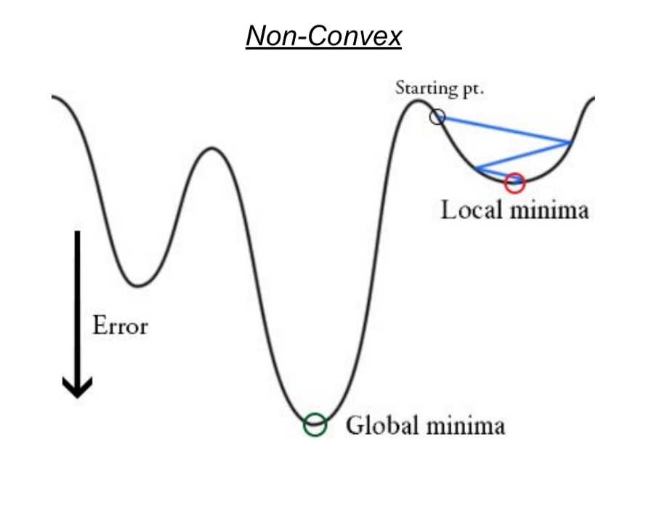
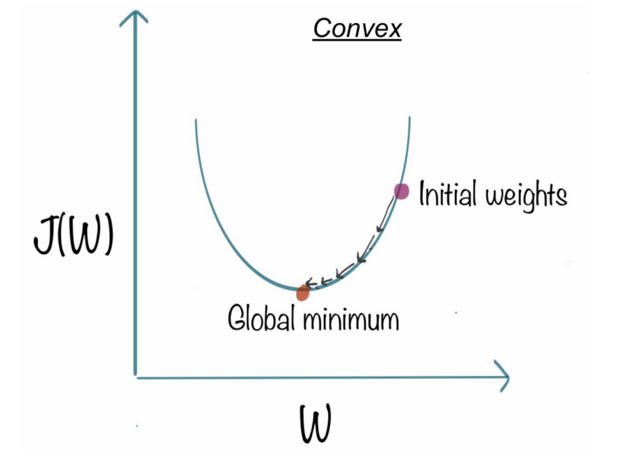
Cost Function
Linear regression uses Least Squared Error as loss function that gives a convex graph and then we can complete the optimization by finding its vertex as global minimum.
However, it’s not an option for logistic regression anymore. Since the hypothesis is changed, Least Squared Error will result in a non-convex graph with local minimums by calculating with sigmoid function applied on raw model output.

Slide 13

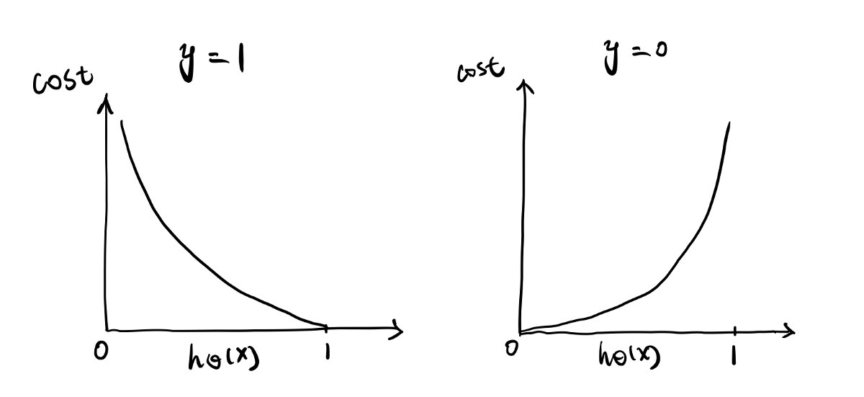
Cost Function
Intuitively, we want to assign more punishment when predicting 1 while the actual is 0 and when predict 0 while the actual is 1.
The loss function of logistic regression is doing this exactly which is called Logistic Loss.
If y = 1, looking at the plot on left, when prediction = 1, the cost = 0, when prediction = 0, the learning algorithm is punished by a very large cost.
Similarly, if y = 0, the plot on right shows, predicting 0 has no punishment but predicting 1 has a large value of cost.

Slide 14
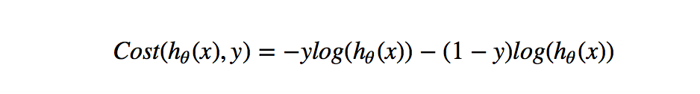
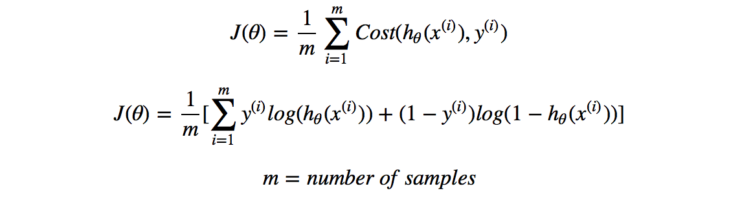
cost function
Another advantage of this loss function is that although we are looking at it by y = 1 and y = 0 separately, it can be written as one single formula which brings convenience for calculation: top 1st Picture
So the cost function of the model is the summation from all training data samples: 2nd picture

Slide 15
Optimization
With the right learning algorithm, we can start to fit by minimizing J(θ) as a function of θ to find optimal parameters.
We can still apply Gradient Descent as the optimization algorithm.
It takes partial derivative of J with respect to θ (the slope of J), and updates θ via each iteration with a selected learning rate α until the Gradient Descent has converged.

Slide 16
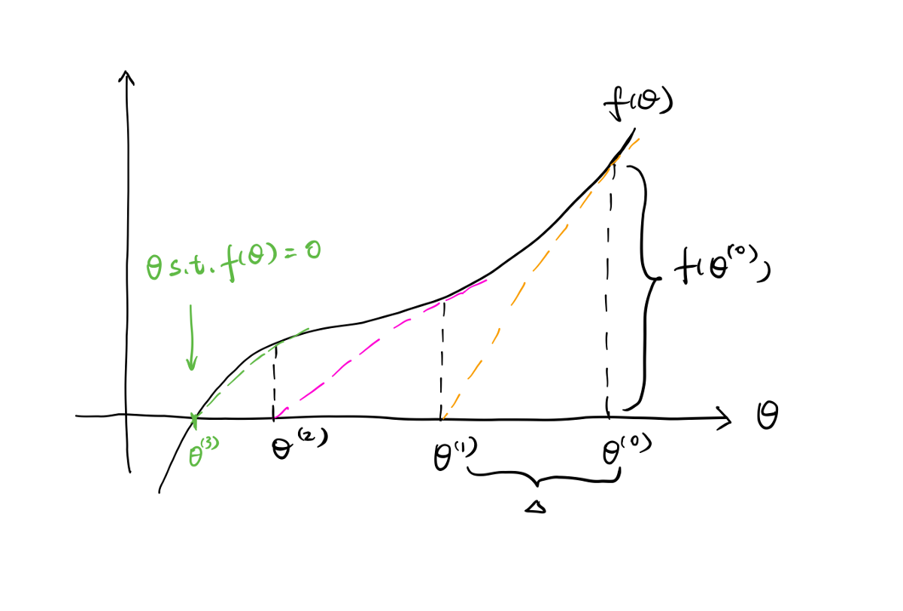
Newton’s Method
another popular optimization algorithm, Newton’s Method, that applies different approach to reach the global minimum of cost function.
Similar to Gradient Descent, we firstly take the partial derivative of J(θ) that is the slope of J(θ), and note it as f(θ).
Instead of decreasing θ by a certain chosen learning rate α multiplied with f(θ) , Newton’s Method gets an updated θ at the point of intersection of the tangent line of f(θ) at previous θ and x axis.
After amount of iterations, Newton’s Method will converge at f(θ) = 0.

Slide 17
Newton’s Method
See the simplified plot, Starting from the right, the yellow dotted line is the tangent of f(θ) at the θ0.
It determines the position of θ1, and the distance from the θ0 to θ1 is Δ.
This process repeats until finding the optimal θ that subjects to f(θ) = 0, which is θ3 in this plot.

Slide 18
Maximum likelihood estimation
Maximum-likelihood estimation is a common learning algorithm used by a variety of machine learning algorithms, although it does make assumptions about the distribution of your data.
the best coefficients would result in a model that would predict a value very close to 1 (e.g. male) for the default class and a value very close to 0 (e.g. female) for the other class.
The intuition for maximum-likelihood for logistic regression is that a search procedure seeks values for the coefficients (Beta values) that minimize the error in the probabilities predicted by the model to those in the data (e.g. probability of 1 if the data is the primary class).

Slide 19
Prepare Data for Logistic Regression
The assumptions made by logistic regression about the distribution and relationships in your data are much the same as the assumptions made in linear regression.
Binary Output Variable: This might be obvious as we have already mentioned it, but logistic regression is intended for binary (two-class) classification problems. It will predict the probability of an instance belonging to the default class, which can be snapped into a 0 or 1 classification.
Remove Noise: Logistic regression assumes no error in the output variable (y), consider removing outliers and possibly misclassified instances from your training data.
Remove Correlated Inputs: Like linear regression, the model can overfit if you have multiple highly-correlated inputs. Consider calculating the pairwise correlations between all inputs and removing highly correlated inputs.
It does assume a linear relationship between the input variables with the output. Data transforms of your input variables that better expose this linear relationship can result in a more accurate model.
Fail to Converge: It is possible for the expected likelihood estimation process that learns the coefficients to fail to converge. This can happen if there are many highly correlated inputs in your data or the data is very sparse (e.g. lots of zeros in your input data)

